Slide 1
A Comparative Study of Parallel Metaheuristics for Protein Structure Prediction on the Computational Grid
Alexandru-Adrian Tantar, Nouredine Melab, El-Ghazali Talbi,
International Parallel and Distributed Processing Symposium (IPDPS 2007), IEEE CNF, pp. 1~10.
Presenter : Hsiao-Yen Chang
Date : January 29, 2008

Slide 2
Abstract
A comparative study of parallel metaheuristics executed
in grid environments is proposed, having as case study a
genetic algorithm, a simulated annealing algorithm and a
random search method. The random search method was
constructed in order to offer a lower bound for the
comparison. Furthermore, a conjugated gradient local
search method is employed for each of the algorithms, at
different points on the execution path. The algorithms are
evaluated using the protein structure prediction problem,
the benchmark instances consisting of the tryptophan-cage
protein and α-cyclodextrin.

Slide 3
Abstract (cont.)
The algorithms are designed to benefit from the grid
environment although having no particular optimization for
the specified benchmarks. The presented results are
obtained by running the algorithms independently and, in a
second time, in conjunction with the conjugated gradient
search method. Experimentations were performed on a
nation-wide grid reuniting five distinct administrative
domains and cumulating 400 CPUs. The complexity of the
protein structure prediction problem remains prohibitive as
far as large proteins are concerned, making the use of
parallel computing on the computational grid essential for
its efficient resolution.

Slide 4
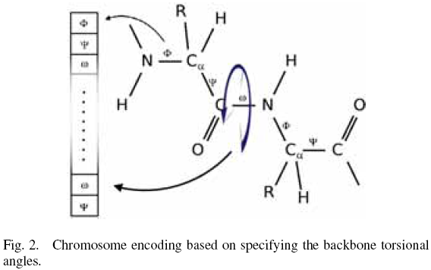
A. Encoding of the conformations

Slide 5
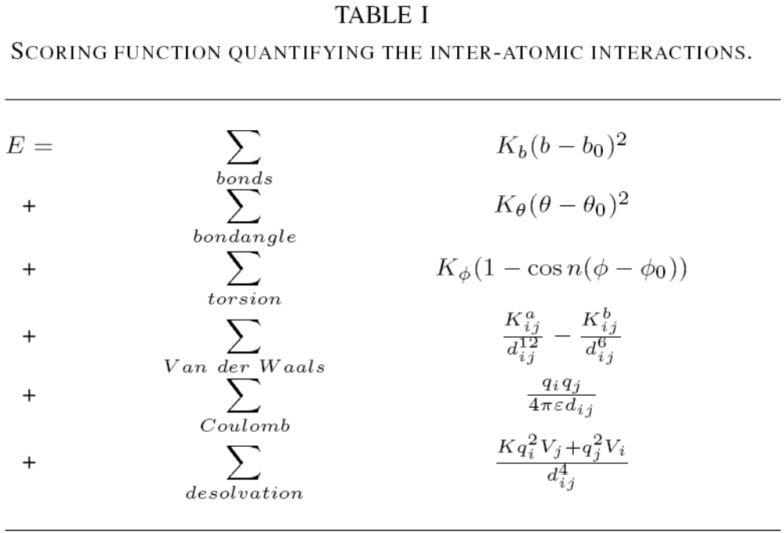
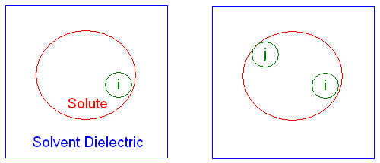
B. Scoring function
The Amber, CHARMM and OPLS force fields.

Slide 6
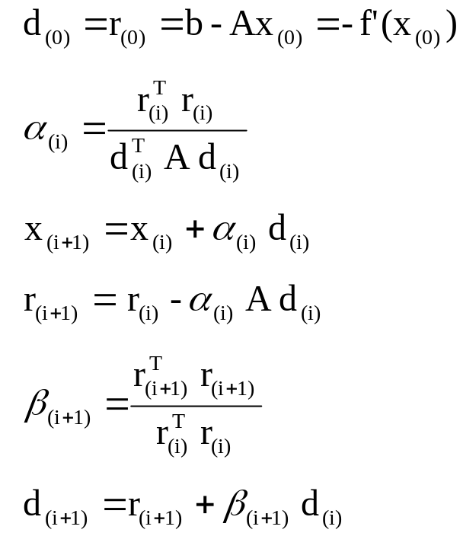
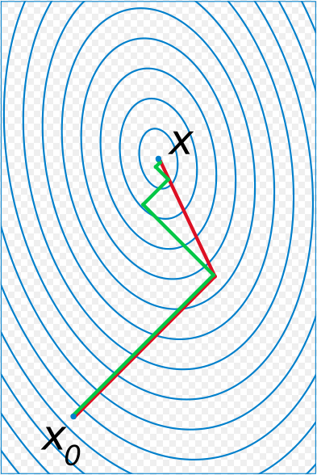
C. Conjugated Gradient Local Search
Set u = r
The residual has the nice property that it’s orthogonal to the previous search directions, so it’s guaranteed always to produce a new, linearly independent search direction unless the residual is zero, in which case the problem is already solved.
A comparison of the convergence of gradient descent with optimal step size and conjugate gradient for minimizing the quadratic form associated with a given linear system. Conjugate gradient converges in at most n steps where n is the size of the matrix of the system (here n=2).

Slide 7
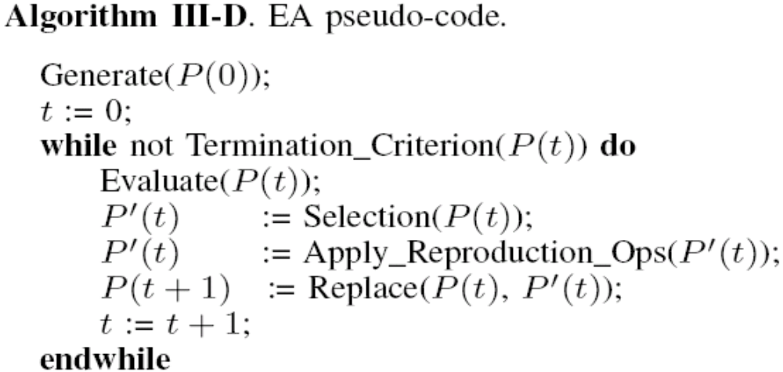
D. Genetic Algorithm
Evolutionary algorithm

Slide 8
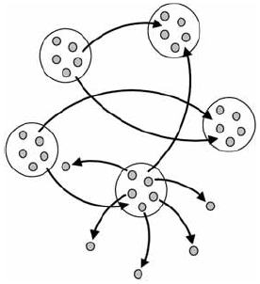
D. Genetic Algorithm (cont.)
Island deployment model and parallel evaluation of the individuals.

Slide 9
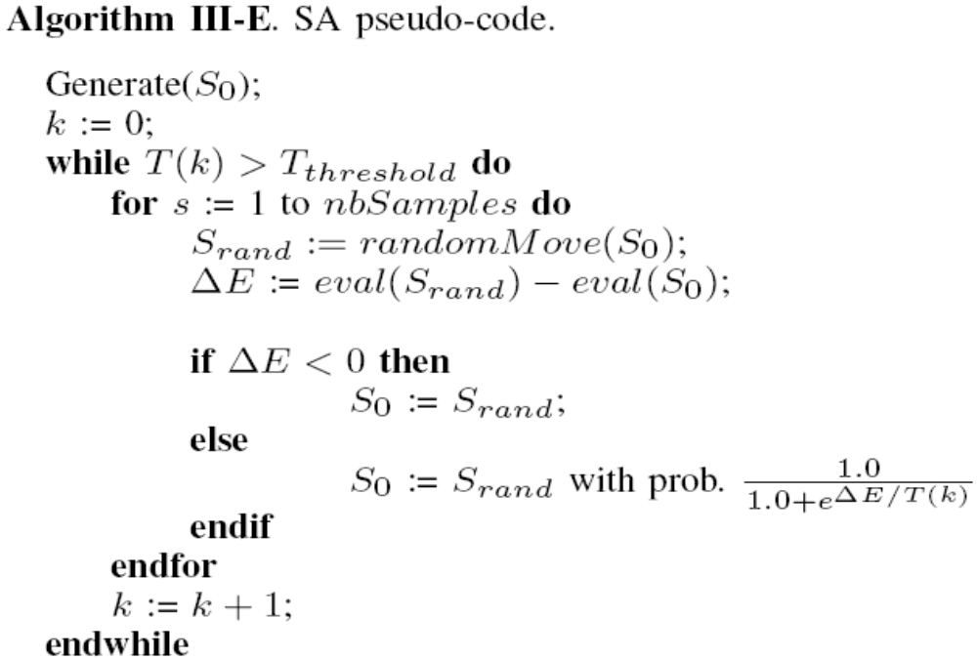
E. Simulated Annealing Algorithm
Monte-Carlo Simulation

Slide 10
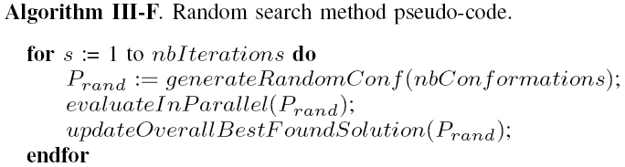
F. Random search method

Slide 11
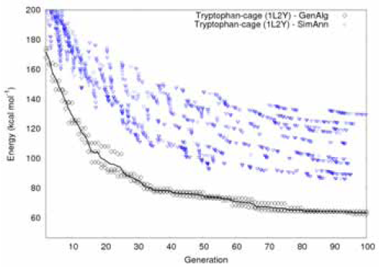
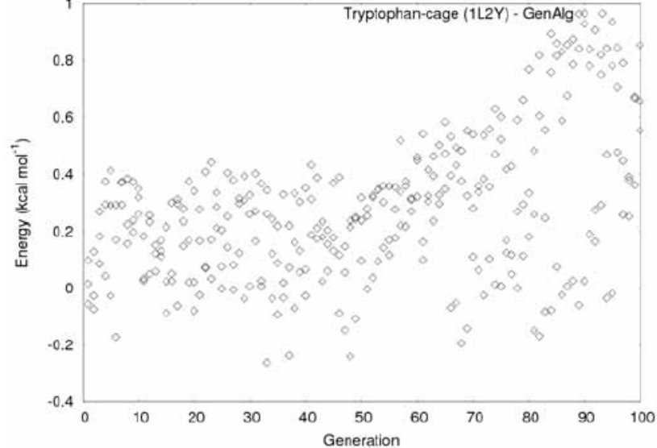
Results
Fig. 6. Experimental results - execution of an island-model genetic algorithm hybridized with a conjugated gradient local search method. As an overlay, on the first picture, the search paths of several synchronously started simulated annealing algorithms - only the improvement points were depicted. The second picture offers an image of the GA fitness decorrelation over the generations.

Slide 12
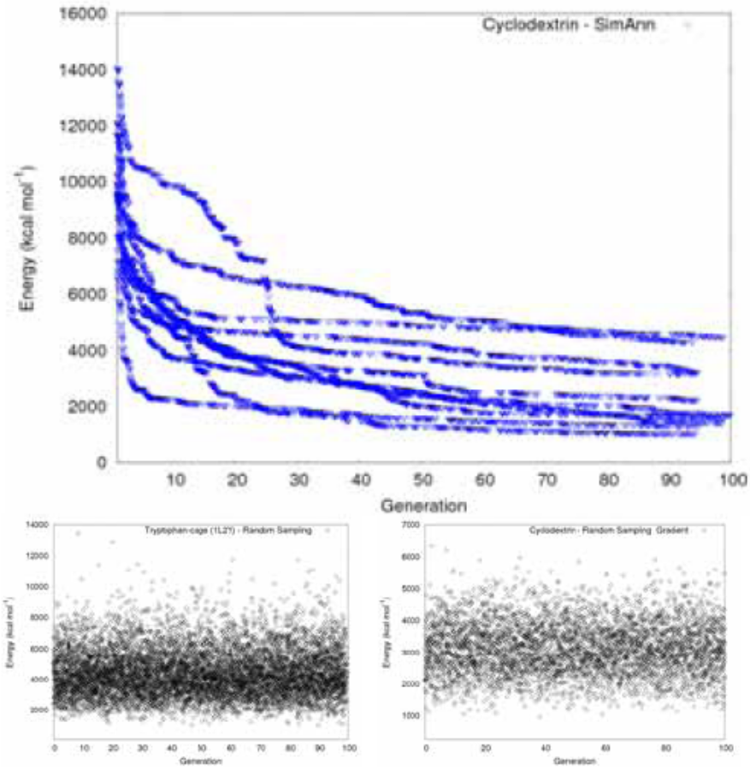
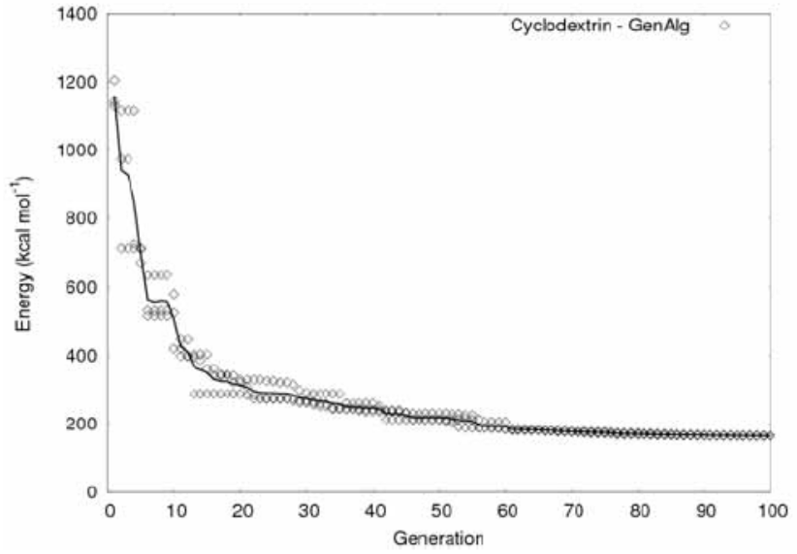
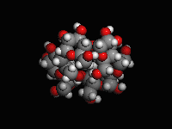
Results (cont.)
Fig. 7. Experimental results for α-cyclodextrine, using the genetic algorithm combined with the
gradient local search method.
Fig. 8. Experimental results: first row - results for α-cyclodextrine using the simulated annealing algorithm; second row - random search method results for 1L2Y (no gradient search applied) and α-cyclodextrine (combined with the gradient
search), respectively.

Slide 13
Results (cont.)
Energy Algorithm | Average (kcal mol⁻¹) | Stdev (kcal mol⁻¹) | Maximum (kcal mol⁻¹) | Minimum (kcal mol⁻¹)
GA + CG | 201.37 | 21.82 | 243.05 | 161.69
GA | 3790.56 | 708.54 | 5845.27 | 2470
SA | 2359.26 | 281.12 | 4593 | 1029.14

